Slide 1

HW #2: Juce Wah-Wah effect
Group:
Group: Radical Geeks
Components:
Gerardo Cicalese (ID: 10776504)
Alberto Bollino (ID: 10865248)
Umberto Derme (ID: 10662564)
Giorgio Granello (ID: 10869436)
Computer Music - Languages and Systems
Homework 1 - Supercollider

Slide 2
The wah-wah effect is an effect that alters the tone and frequencies of the input signal to create a distinctive sound, mimicking the human voice saying the onomatopeic name ”wah-wah”.
OVERVIEW OF WAH-WAH EFFECT
WAH-WAH EFFECT
TECHNICAL DETAILS
The wah-wah effect consists in a passband filter, whose central frequency varies over time.
The original effect consists in a pedal whose pressure controls the central frequency of the filter, while the auto wah-wah effect has an algorithm which makes the central frequency sweep in a prescribed range and according to a modulating function.

Slide 3
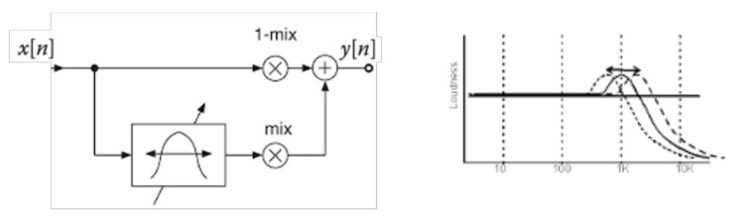
The input signal is splitted in wet and dry components. The wet component goes through a passband filter and then is summed again to the dry component, which becomes the output.
SIGNAL PATH

Slide 4
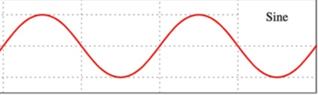
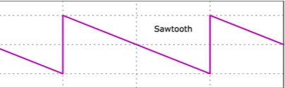
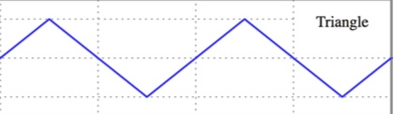
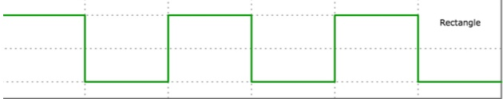
PASS-BAND FILTER
The main block of our plugin is the pass-band filter.
Its central frequency is continuously updated by a routine which makes it vary in a range defined by the user
The function that controls the central frequency can be chosen by the user (sine, tri, saw, rect)
The user can also control the peak gain and quality

Slide 5
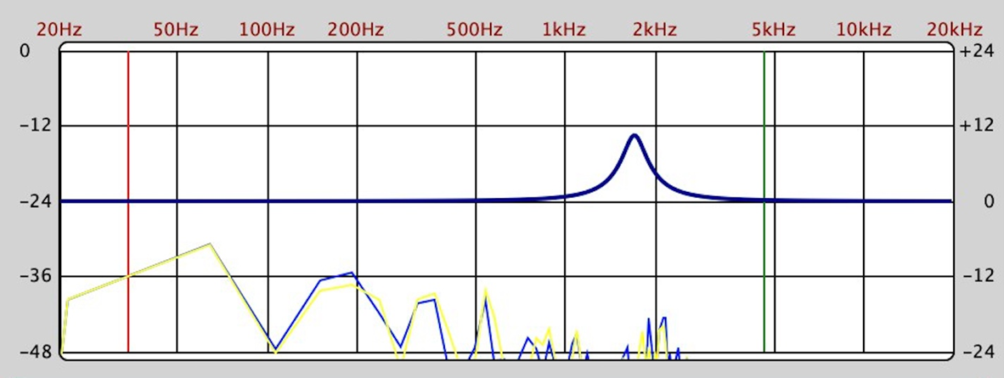
FREQUENCY ANALYZER
In the plugin’s window, we have a frequency analyzer:
It shows the frequency response of the filter, continuously updated while it sweeps up and down
It can show (if the user wants) the FFT of the input signal, so that the user can design the filter to be consistent with it

Slide 6
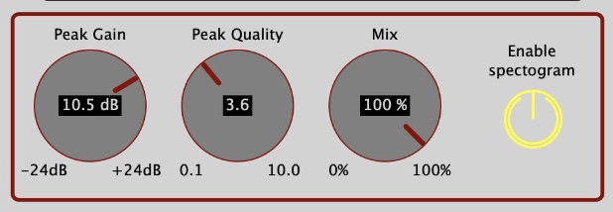
WET/DRY EFFECT
We added a Wet/Dry knob (mix), so that the user can control the percentage of the input signal that must be affected by the wah-wah effect.

Slide 7
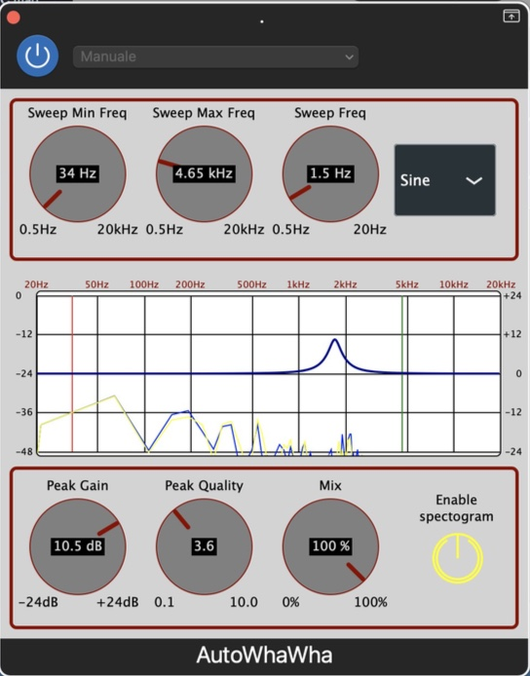
GUI
On the first row:
The first two knobs control the limits of the peak sweep
The third knob controls the sweep function’s frequency
With the drop-down menu you can select the sweep function
On the last row:
The first knob controls the gain of the peak
The second one controls the quality of the peak
The last knob manages the wet/dry effect
The button enables the visualitation of the FFT of the input signal on the frequency analyzer

Slide 8

DEMO

Slide 9
THANKS FOR YOUR ATTENTION

